Slide 1

SMART ATTENDANCE
(Using Face Recognition)
By:
Bedabrata bora - 1706123
Priyanka raj - 1706145
satyam shah - 1706157
shashwata mukherjee - 1706160

Slide 2
Introduction
Maintaining the attendance records is very important for every organization. They have there own method to do the same.
The manual method includes pen and papers which consumes a lot of time and wastage of resources. It also has risks of proxies and human error.
The management of the attendance can be a great burden on the teachers if it is done by hand. To resolve this problem, smart and auto attendance management system is being utilized.

Slide 3
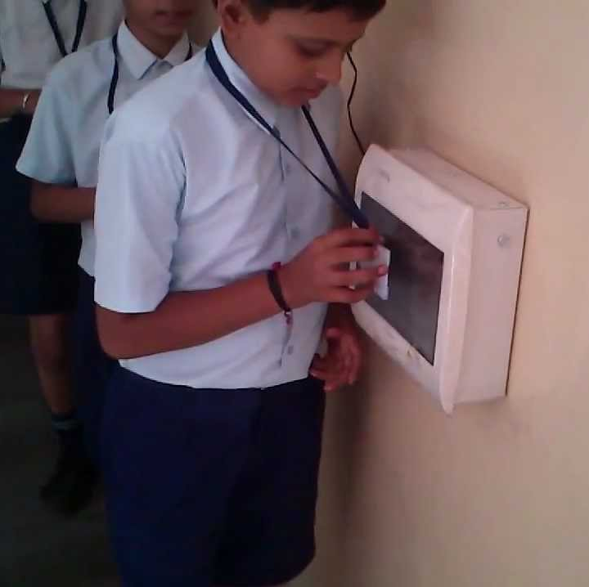
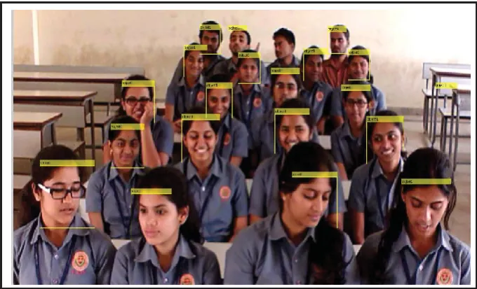
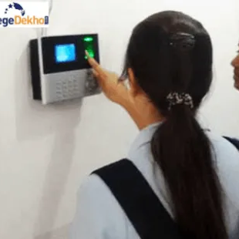
Automated Methods
Biometric
It includes fingerprint, iris and voice recognition.
Biometric authentication systems are not 100% accurate.
RFID
An individual has to carry his/her own RFID card.
Can also gives rise to fraud as any unauthorized person can use the card for fake attendance.
Face Recognition
Fast and reduces the chance of fake attendance.
Records attendance by detecting faces of students via camera.

Slide 4
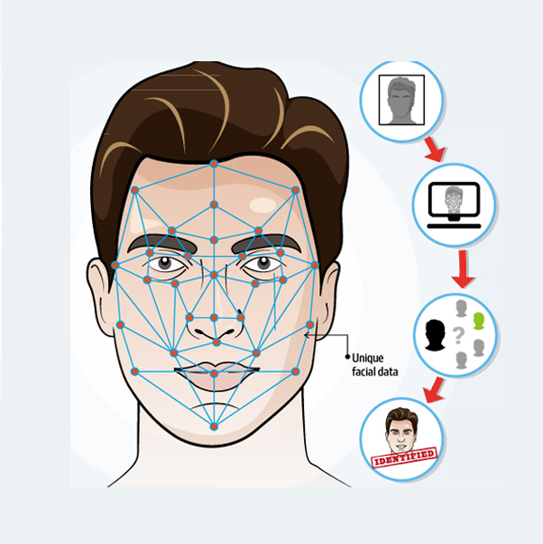
Face Recognition
The basic steps Face Recognition involves :
Capturing the Student's image of the face.
Storing the images in the database.
Detecting the face and matching the detected face with the database.
If matched then API request from the database and load data to the Firebase database.
Data can be retrieved from the Firebase.
Log in the application and check the attendance.

Slide 5
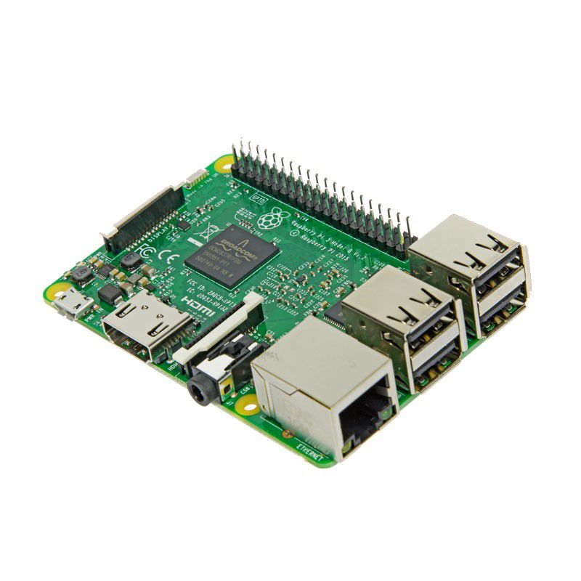
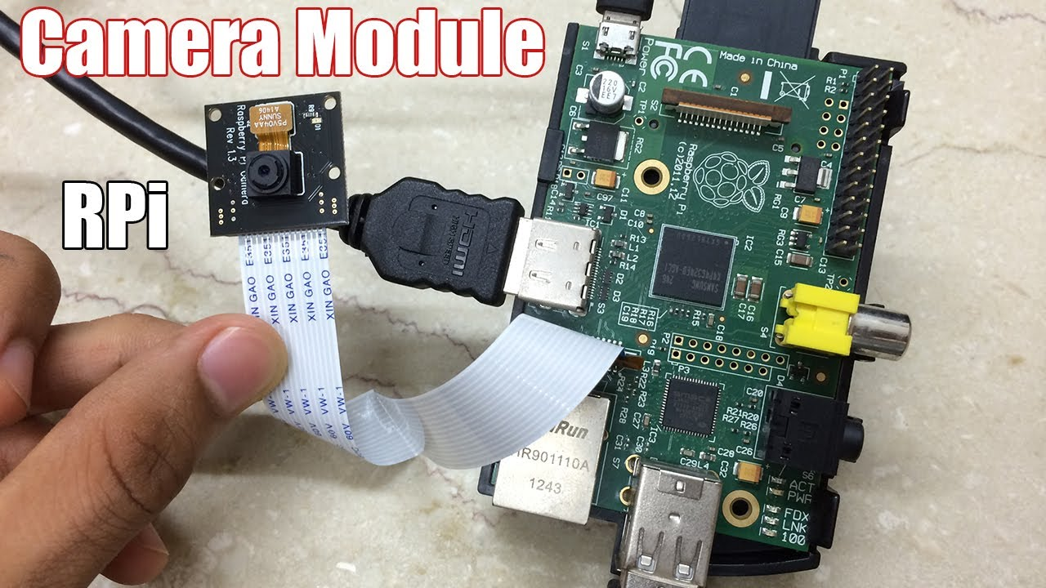
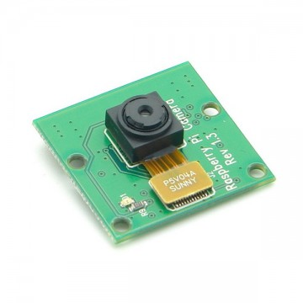
Hardware Components
Camera module
Responsible for capturing the face data.
A camera module with a good sensor is preferred.
The hardware connection of Raspberry pi with the camera module.
The VGA cable is used to connect to a monitor system.
This system is connected to a power input of 5V at 2A via the Micro USB cable.
The USB cable is used to connect any external device for the input method to the Raspberry pi (like Keyboard, Mouse, etc)
Raspberry pi - 3
It acts as the medium for transferring data to the AWS data base where face detection and recognition is done.
User can use any version of the Raspberry pi board.

Slide 6
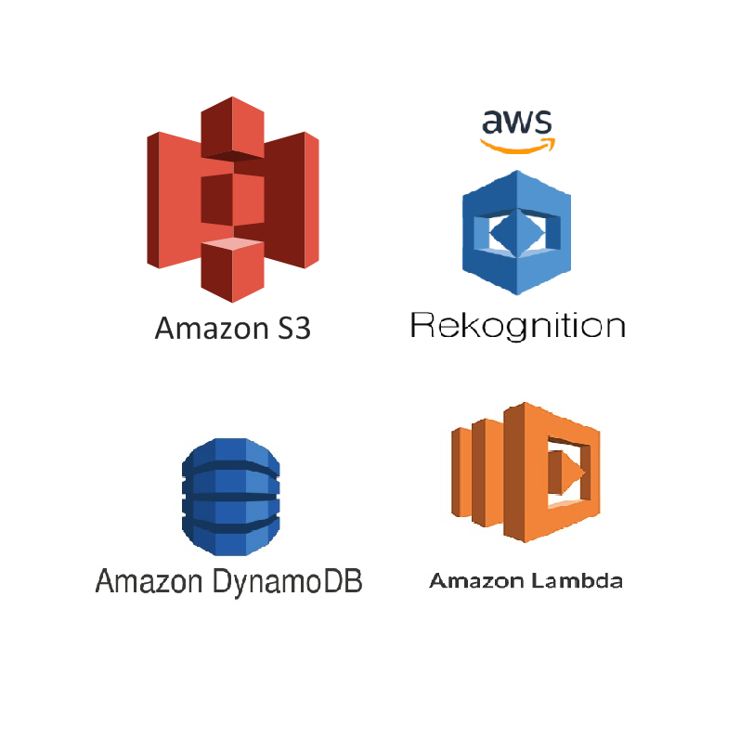
Software Components (AWS Services)
In our project, we have used Amazon Web Services (AWS) which includes :
S3 Bucket : It is a cloud object storage We are using S3 bucket to store all images of students. These images will be used by Index Face API to filter faces and store them as face images in collection.
Dynamo Db : Dynamo db is fully managed NoSQL database service. We are using this to store the full name of the student from the metadata of the object in Amazon S3. It is stored as key-value tuple with the FaceId in the DynamoDB table for later reference. We also use a different table to to update the attendance of everyday.
IAM : Identity and Access Management enables you to manage access to AWS services and resources securely.
Lambda : Lambda function is used to automate and scale the task .It uses the Amazon Rekognition IndexFaces API to detect the face in the input image add adds it to the specified collection. If successful, it retrieves the full name of the person from the metadata of the object in Amazon S3. Then it stores this as a key-value tuple with the FaceId in the DynamoDB table for later reference.
Amazon Rekognition: It is a cloud-based Software as a service (SaaS) computer vision platform which makes addition and analysis of images easy.

Slide 7
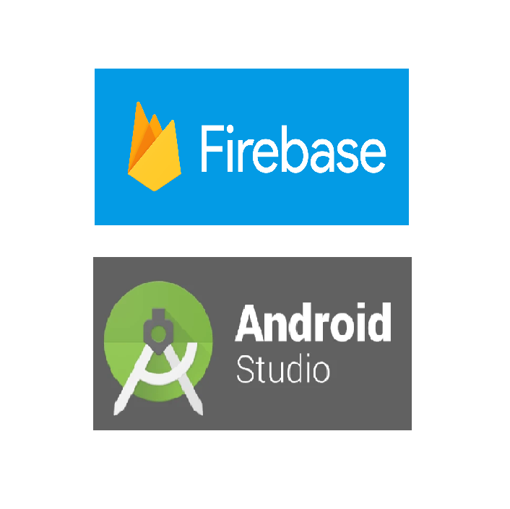
Software Components (Android Studio and Firebase)
Android Studio is the official integrated development environment (IDE) for Google's Android Development System. It is a software designed specifically for Android Development.
We use Android Studio for the app development process in our project which would be very beneficial to the admin (Student/Teacher) as he/she would get the necessary information about themselves anywhere and anytime irrespective of the presence of a PC/Laptop with him. The app version would be much mobile as compared to the computer systems.
We access the information stored in the AWS Cloud via an API Request which is imported by the Firebase database.
Firebase provides a real-time database and back-end as a service. The service provides application developers an API that allows application data to be synchronized across clients and stored on Firebase's cloud. The Firebase attendance database is accessed by the Android Application and the user is able to see his attendance account.

Slide 8
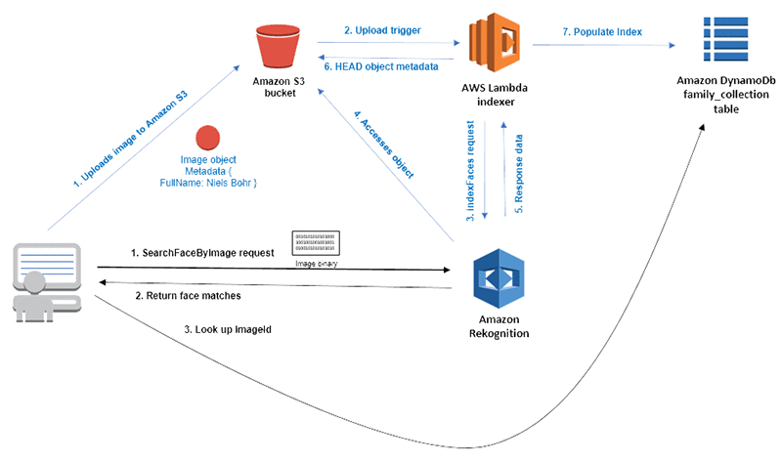
Working of Cloud

Slide 9
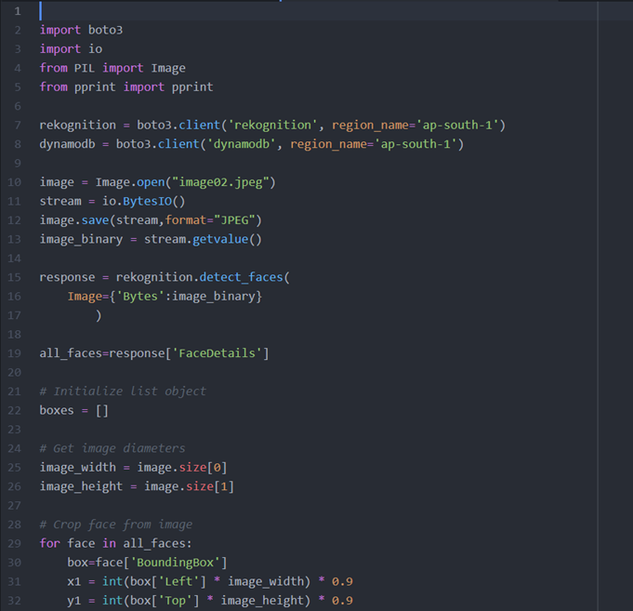
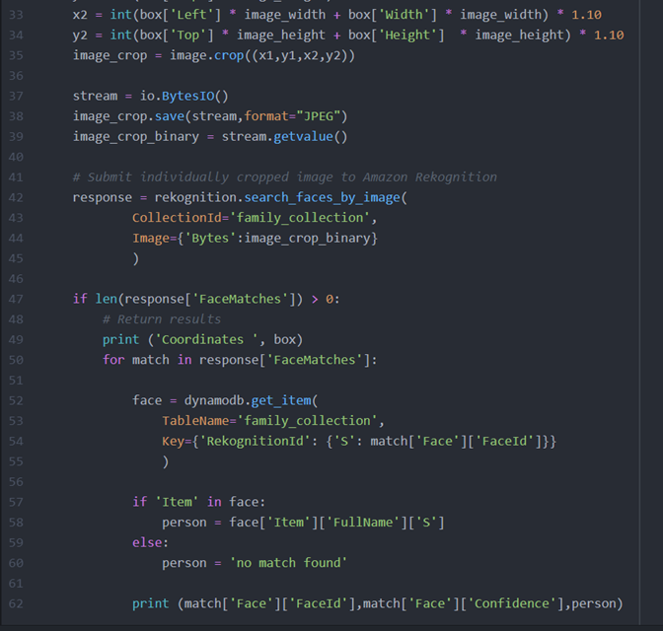
Raspberry pie takes the picture of the student and sends to Amazon Rekognition via SearchFaceByImage request as a byte stream.
Rekognition compares the images in collection and In response, it returns a JSON object containing the metadata(Co-ordinates,Confidence Score, Name ) of the matches.

Slide 10
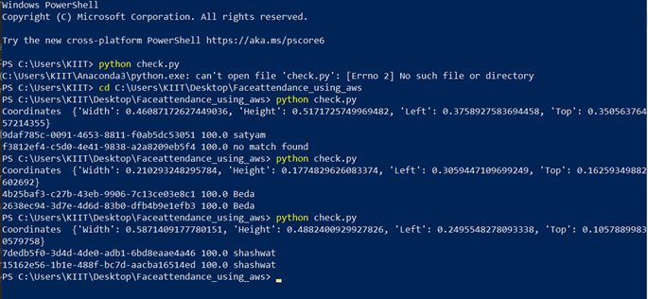
If the confidence score is greater than threshold , we update the dynamo db table with Students name and data.Using Android app, Students can access their attendance from dynamo db.

Slide 11
Working of the Application

Slide 12
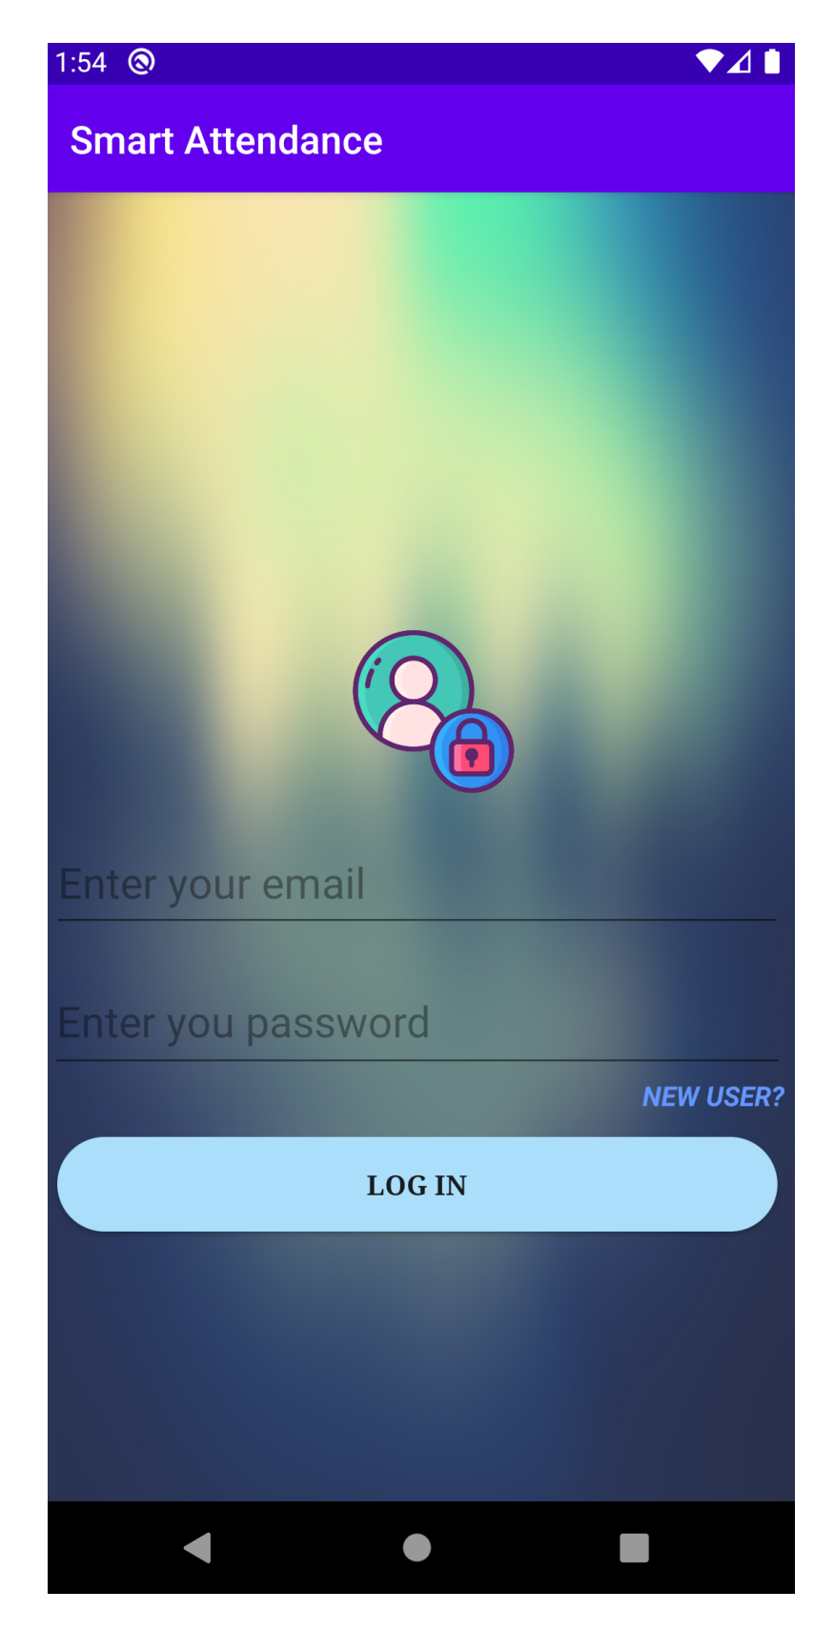
The user is first greeted with a login page. If the user account is already created, then the user can login to their account and view their attendance. Else the can create a new account in the registration Page. ext
The Interface of Login Page.

Slide 13
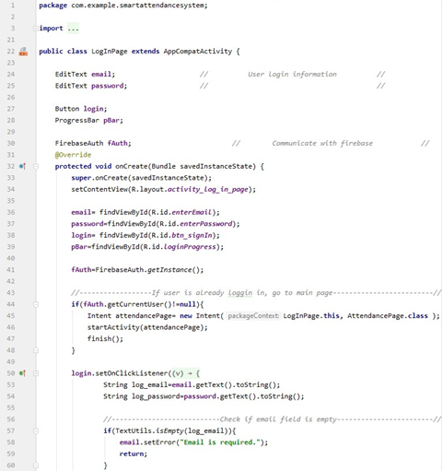
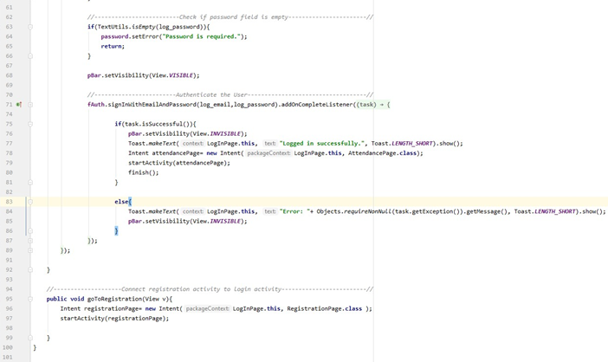
Code Implementation of the Login Page .

Slide 14
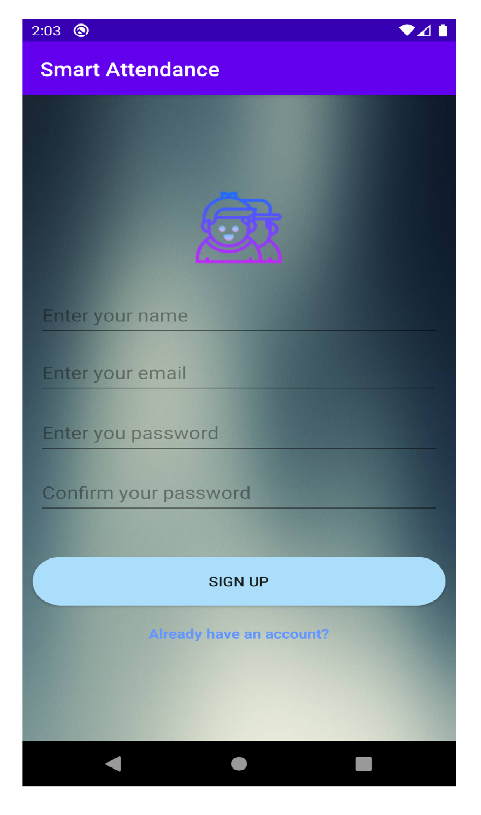
For new users, they will be asked for their full name, email and password with certain constraints.
The Interface of Registration Page.

Slide 15
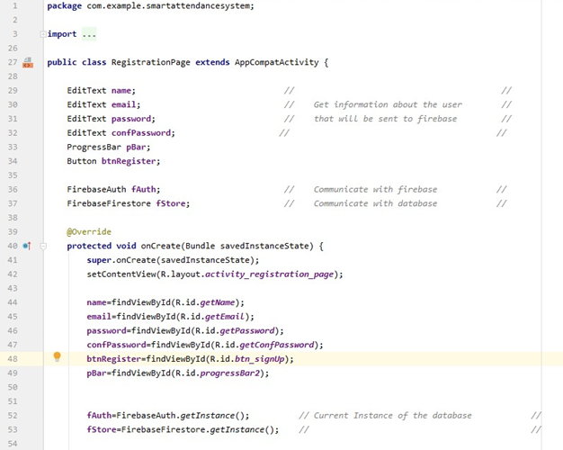
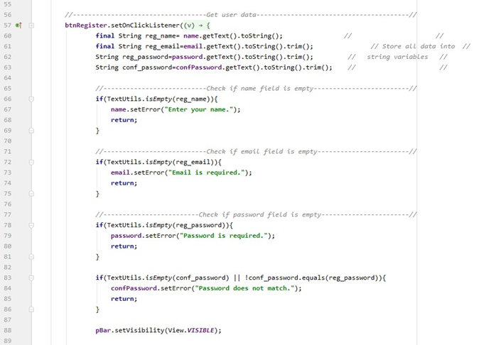
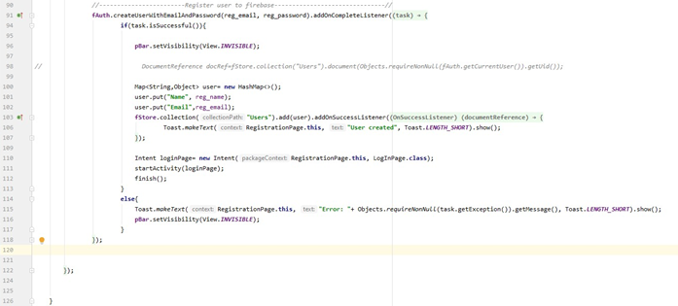
Code Implementation of the Registration Page .

Slide 16
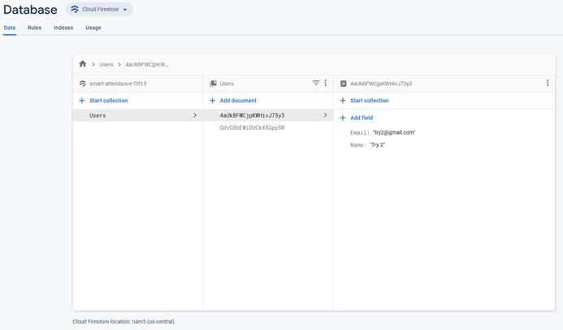
The registered data will be added to the Firebase database for every unique users and will be displayed in the database.

Slide 17
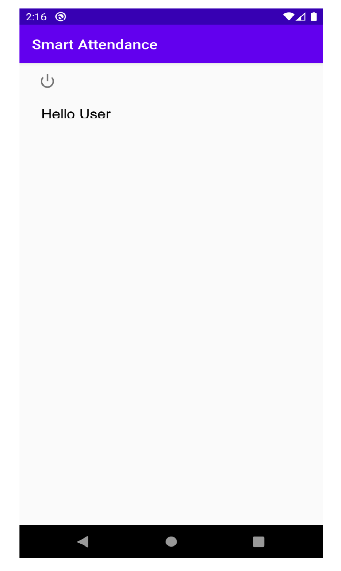
The user data will be displayed on login

Slide 18
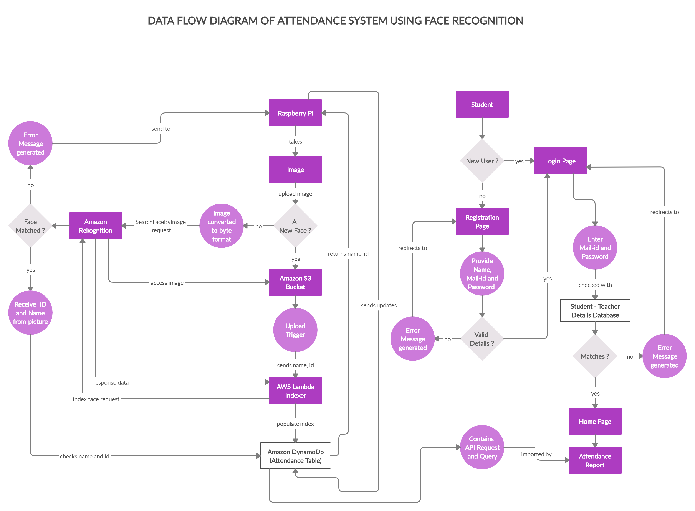

Slide 19
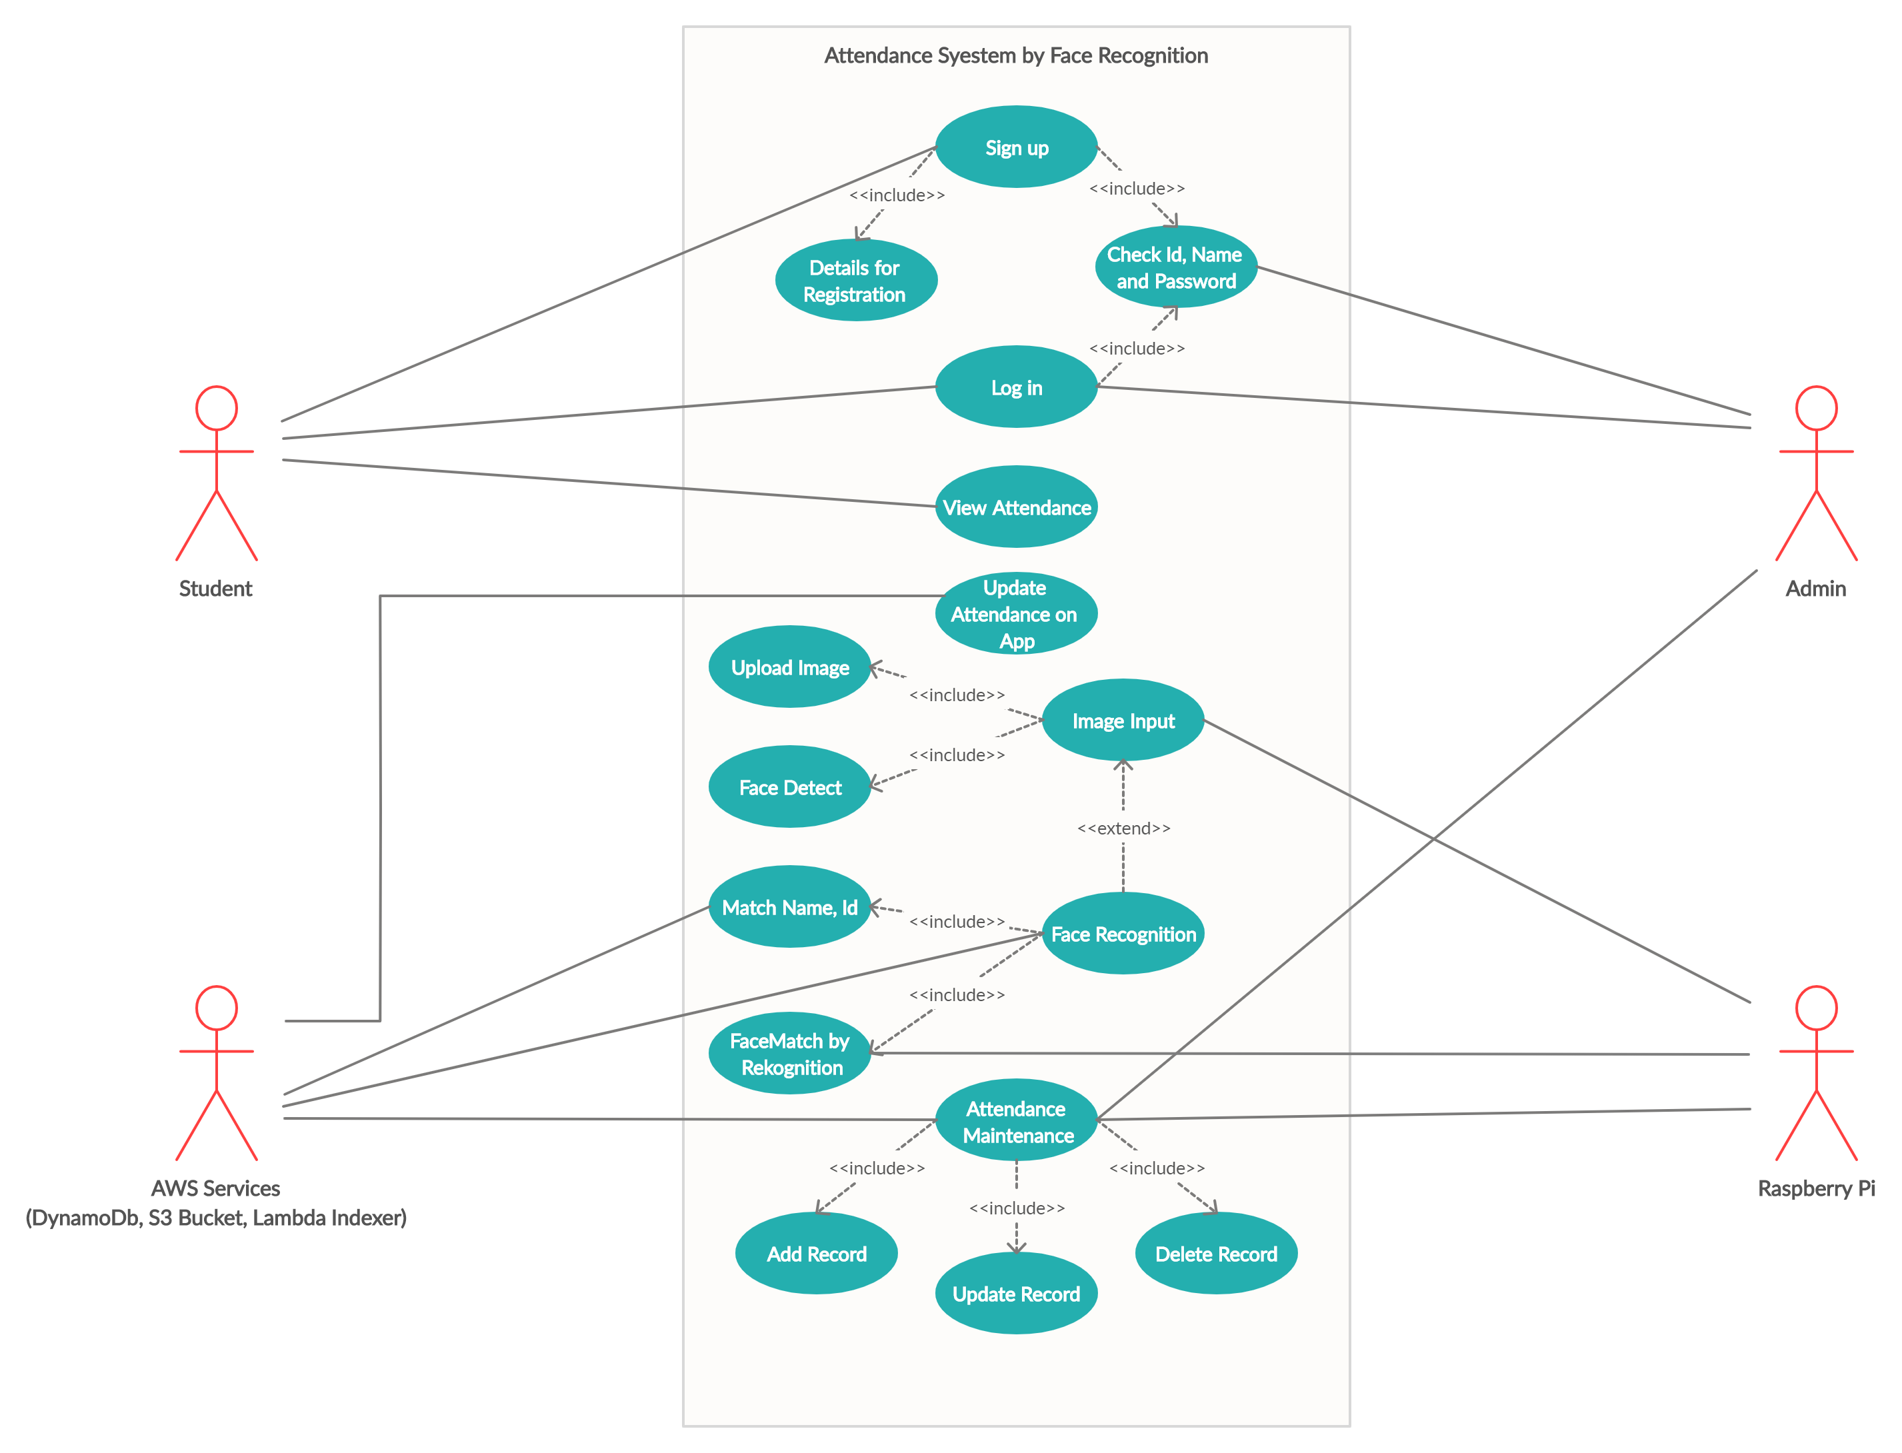

Slide 20
Implementation
In the current status of the project:
Individual modules for the face recognition and app development has been done. Both the Modules are working fine.
We were not able to implement the hardware part of the project due to unavoidable circumstances. Therefore, the integration of the software and the hardware part was not accomplished.

Slide 21
Future Scope of the Project
Amazon is already actively promoting its cloud-based face recognition service named Rekognition to law enforcement agencies. The solution could recognize as many as 100 people in a single image and can perform face match against databases containing tens of millions of faces.
Since Amazon has all the required services, it becomes easy for a developer to access the information, analyze it and provide a frontend for the display of the data. This leads to a huge demand of the developed product.
So, its cutting edge technology will continue to lead in the market with reliability and authenticity.

Slide 22
Thank You

